Slide 1

2025 FEB 21
STABLE PRICE LEVEL(INFLATION) ANALYSIS
IMPACT ON GILEAD SCIENCES, REGENERON AND VERTEX PHARMACEUTICALS
GROUP 2

Slide 2
CONTENTS
Introduction
Inflation Trends in Switzerland
Inflation Trends in Ireland
Impact on Pharmaceutical Companies
Numerical Insights
Strategic Implications
Conclusion
References
4

Slide 3
OBJECTIVES
Analyze inflation’s impact on the pharmaceutical sector in Switzerland and Ireland, focusing on costs, pricing, and profitability.
Provide insights and graphical data on inflation trends and national debt in both countries.
Understand productivity as a key driver of business success and its role in efficiency and competitiveness.
Compare productivity trends in the pharmaceutical industry in Switzerland and Ireland.
Evaluate strategic implications for pharmaceutical firms adapting to inflation, national debt, and enhancing productivity in both countries.
3

Slide 4
INTRODUCTION
Inflation Impact:
Switzerland: Stable inflation ensures predictable costs and easier long-term planning.
Ireland: Dynamic inflation requires flexible strategies to manage rising costs.
Productivity:
Switzerland: High productivity driven by advanced infrastructure and skilled labor.
Ireland: High productivity influenced by favorable tax policies and a skilled workforce.
National Debt:
Switzerland: Low national debt supports fiscal stability and predictable business environment.
Ireland: Higher national debt, but managed with growth-oriented fiscal policies.
Impact on Pharmaceutical Companies (e.g., Gilead Sciences, Regeneron, Vertex Pharmaceuticals):
Switzerland: Offers stability for investments, R&D, and cost management.
Ireland: Requires agile strategies to adapt to inflation and leverage growth opportunities.

Slide 5
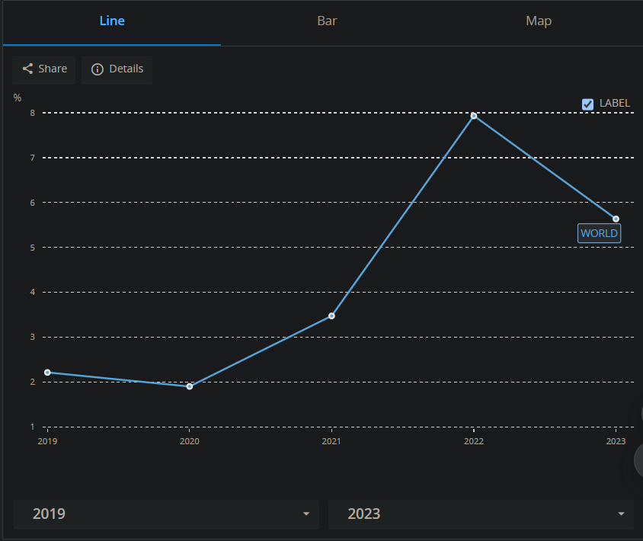
INFLATION TRENDS
SWITZERLAND
Switzerland's inflation rate has remained within the central bank’s target of 0-2% over the past decade.
Contributing factors:
Conservative monetary policies by the Swiss National Bank (SNB)
Strong Swiss franc reducing import price pressures
Low unemployment and stable wage growth
FIG.1 DEPICTS THE INFLATION OF SWITZERLAND IN PHARMACEUTICAL SECTOR

Slide 6
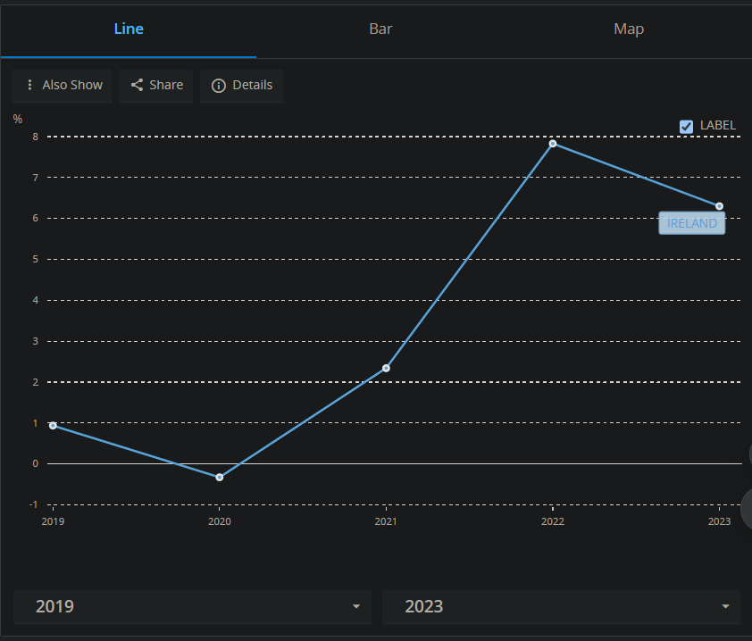
INFLATION TRENDS contd
IRELAND
Ireland has experienced greater inflation volatility due to the following reasons.
Dependence on foreign trade and multinational corporations
Fluctuations in the European Central Bank’s monetary policy
Changes in energy prices and global economic conditions
Inflation rates have ranged between 2.5% - 4.1% (2022-2024)
FIG.2 DEPICTS THE INFLATION OF IRELAND IN PHARMACEUTICAL /BIO-TECHNOLOGY SECTOR

Slide 7
IMPACT ON PHARMACEUTICAL COMPANIES
GILEAD SCIENCES
Headquarters: Foster City, California, USA
Switzerland: Zürich, Basel
Ireland: Carrigtwohill, County Cork (Manufacturing & Distribution)
Swiss Operations:
Gilead Sciences has a significant presence in Zug, Switzerland, where it benefits from the country's stable economic environment and predictable inflation.
Brief History:
Founded in 1987 by Michael L. Riordan.
Initially focused on antiviral drugs, Gilead became a leader in treatments for HIV/AIDS, Hepatitis B & C, and influenza.
Acquired Pharmasset in 2011, leading to groundbreaking Hepatitis C treatments.
Switzerland serves as a strategic location for European market access and stable investment planning due to low inflation and predictable business costs.
8

Slide 8
REGERON PHARMACEUTICALS:
Headquarters: Tarrytown, New York, USA
Switzerland: Not a primary location
Ireland: Limerick (Industrial Operations & Product Supply), Dublin (Commercial & Administration Office)
Swiss Operations:
Ireland serves as a key production hub, but inflation variability affects operational costs, wages, and supply chain expenses.
Brief History:
Founded in 1988 by Leonard Schleifer and George Yancopoulos.
Initially focused on neurological diseases, later became a leader in monoclonal antibodies for cancer, eye diseases, and COVID-19 treatments.
Developed Eylea (for macular degeneration) and Dupixent (for asthma & eczema).
Ireland serves as a key production hub, but inflation variability affects operational costs, wages, and supply chain expenses.
8

Slide 9
VERTEX PHARMACEUTICALS:
Headquarters: Boston, Massachusetts, USA
Switzerland: Zürich (European Headquarters)
Ireland: Dublin (Manufacturing & Research & Development)
Swiss Operations:
Operates in both Switzerland and Ireland, requiring flexible financial strategies due to varying inflation impacts.
Brief History:
Founded in 1989 by Joshua Boger.
Pioneered cystic fibrosis (CF) treatments, with drugs like Kalydeco, Orkambi, and Trikafta.
Strong presence in gene therapy and rare diseases research.
Operates in both Switzerland and Ireland, requiring flexible financial strategies due to varying inflation impacts.
8

Slide 10
COMPARATIVE ANALYSIS OF INFLATION
Factor | Switzerland (Gilead Sciences) | Ireland (Regeneron, Vertex Pharmaceuticals)
Average Inflation Rate (2022-2024) | 1.2% | 2.5% - 4.1%
Wage Growth (Annual) | 1.5% | 2.8% (fluctuates based on inflation)
Raw Material Cost Increase (Annual) | 1.8% | 3.5%
Energy Cost Fluctuation | Stable (Government regulations) | High volatility due to global oil price changes
Distribution Costs (Logistics & Transportation) | 2.0% increase per year | 3.8% increase per year
Impact on Pricing Strategy | Predictable, allowing stable long-term pricing | Requires dynamic pricing adjustments
Investment Planning | Long-term, minimal uncertainty | Short-term, requires flexible strategies

Slide 11
NUMERICAL INSIGHTS
SWITZERLAND
IRELAND
2022-2024 average inflation: 1.2%
Wages have grown steadily at ~1.5% annually
Energy prices stable due to government interventions
2022-2024 inflation: fluctuated between 2.5% and 4.1%
Wage growth inconsistent, influenced by foreign investments
Energy prices more volatile, affecting production costs

Slide 12
STRATEGIC IMPLICATIONS
SWITZERLAND
IRELAND
Predictable inflation fosters stable investment and long-term financial planning
Minimal impact on pricing strategies, ensuring steady revenue growth
Inflation volatility requires dynamic pricing and cost-control measures
Companies must hedge against rising production costs through flexible supply chains

Slide 13
2025 FEB 21
PRODUCTIVITY ANALYSIS
IMPACT ON GILEAD SCIENCES, REGENERON AND VERTEX PHARMACEUTICALS
GROUP 2

Slide 14
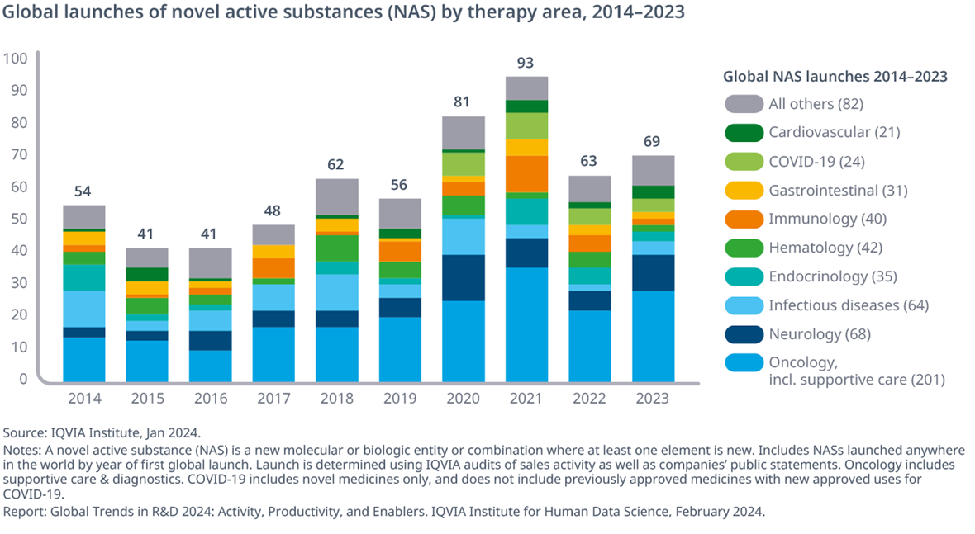
PRODUCTIVITY TRENDS
GLOBAL TRENDS
Developed economies have experienced steady productivity growth due to technological innovations.
Emerging markets show varying productivity trends, with rapid industrialization in some regions and stagnation in others.
FIG.1 DEPICTS GLOBAL TRENDS IN PRODUCTIVITY

Slide 15
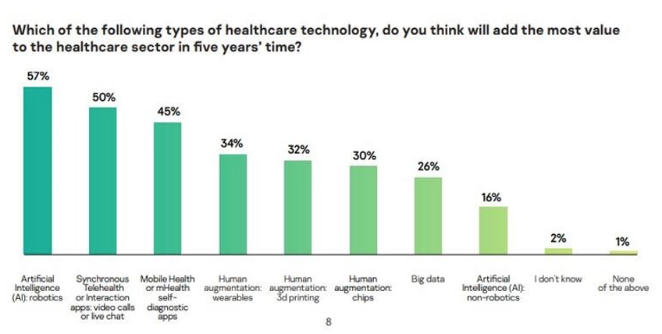
PRODUCTIVITY TRENDS
SECTOR - SPECIFIC PRODUCTIVITY TRENDS
Manufacturing: Increased automation and AI integration have led to higher productivity levels.
Services: Digital transformation is driving efficiency, particularly in finance and healthcare.
Agriculture: Precision farming and biotechnology are enhancing output per hectare.
FIG.2 DEPICTS SECTOR-SPECIFIC PRODUCTIVITY TRENDS

Slide 16
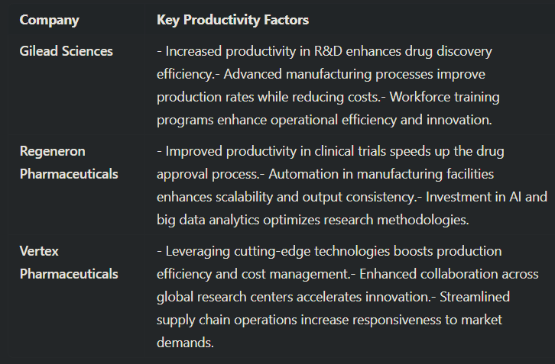
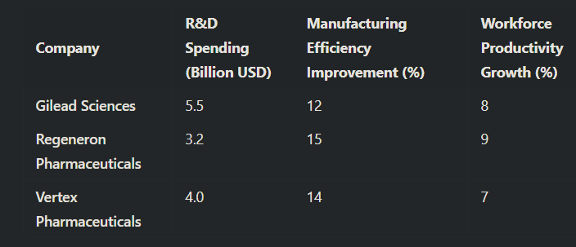
IMPACT ON PHARMACEUTICAL COMPANIES
8

Slide 17
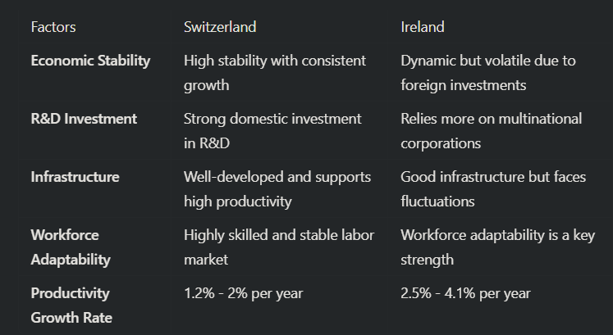
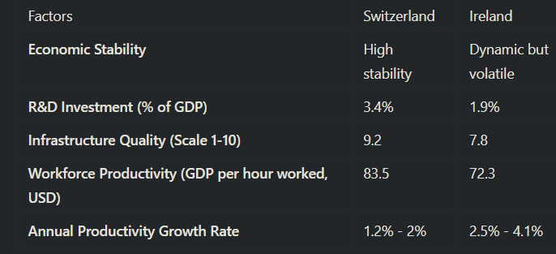
COMPARATIVE ANALYSIS OF PRODUCTIVITY

Slide 18
FACTORS AFFECTING PRODUCTIVITY
Technology & Innovation: Automation, AI, and data analytics improve efficiency.
Human Capital: Education, skills, and workforce training play a crucial role.
Infrastructure: Efficient transportation, energy supply, and digital infrastructure enhance productivity.
Economic Policies: Government policies on taxation, investment, and trade impact productivity levels.
4

Slide 19
NUMERICAL INSIGHTS
DEVELOPED ECONOMIES
EMERGING MARKETS
Average productivity growth: 1.5% - 2.5% per year (2022-2024).
High investment in automation and digital transformation.
Productivity growth fluctuates between 2% - 5%, depending on sectoral investments.
Labor-intensive industries show slower improvements compared to technology-driven sectors.

Slide 20
STRATEGIC IMPLICATIONS
Investment in Technology: Companies must adopt AI and automation to enhance efficiency.
Workforce Development: Training and upskilling employees are crucial for sustained productivity growth.
Infrastructure Development: Governments and businesses should collaborate to improve infrastructure.
Agile Business Strategies: Companies must adapt to economic fluctuations and technological advancements.

Slide 21
2025 FEB 21
THE NATIONAL DEBT
IMPACT ON GILEAD SCIENCES, REGENERON AND VERTEX PHARMACEUTICALS
GROUP 2

Slide 22
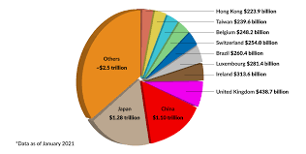
NATIONAL DEBT
SWITZERLAND
IRELAND
Public debt ratio: 40-45% of GDP** (stable and well-managed).
Fiscal prudence ensures low tax burdens and financial predictability.
Positive business environment benefiting pharmaceutical investments.
Budget surplus of €8.6 billion in 2024, driven by corporate tax revenues.
More dynamic fiscal policy with reinvestments into infrastructure and public services.
Opportunities and risks for businesses due to economic fluctuations.

Slide 23
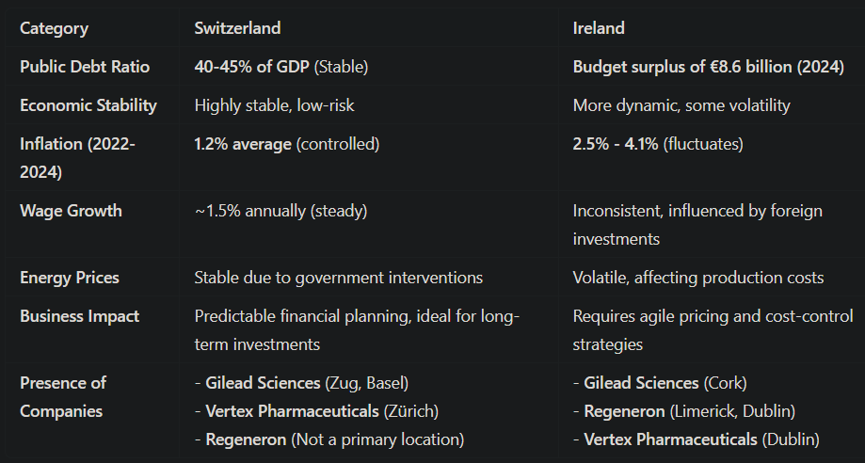
IMPACT ON PHARMACEUTICAL COMPANIES
&
COMAPARATIVE ANALYSIS
8

Slide 24
NUMERICAL INSIGHTS
SWITZERLAND
IRELAND
Budget surplus of €8.6B (2024), but volatile inflation (2.5%-4.1%)
Corporate tax revenue reliance & fluctuating energy costs
Dynamic pricing & cost-control strategies required
Attractive corporate tax benefits & strong pharma presence
Stable economy with 40-45% debt-to-GDP
Low inflation (~1.2%), steady wage growth
Ideal for long-term investments & R&D
Minimal tax fluctuations & cost risks

Slide 25
STRATEGIC IMPLICATIONS
SWITZERLAND
With stable debt levels (40-45% of GDP) and controlled inflation (~1.2%), Switzerland will continue to be a low-risk investment hub for pharmaceutical companies.
Future growth will be driven by sustained R&D investments, innovation incentives, and financial predictability.
Companies can expect minimal regulatory and tax fluctuations, allowing for long-term financial planning and expansion.
IRELAND
Ireland’s budget surplus (€8.6B) and strong corporate tax revenues will keep attracting pharmaceutical and biotech investments.
However, inflation volatility (2.5%-4.1%) and fluctuating energy costs may create future financial uncertainties.
Companies must adopt adaptive pricing, flexible supply chains, and cost-hedging strategies to navigate economic fluctuations.

Slide 26
CONCLUSION
In conclusion, both Switzerland and Ireland offer unique advantages and challenges for pharmaceutical companies like Gilead Sciences, Regeneron, and Vertex Pharmaceuticals.
Switzerland’s economic stability fosters a predictable environment ideal for long-term R&D and investments, while Ireland’s dynamic growth presents opportunities tempered by inflation risks and economic fluctuations.
By closely monitoring productivity trends, inflation, and national debt, companies can strategically align their operations to leverage Switzerland’s stability and Ireland’s growth potential, ensuring long-term sustainability and optimized profitability.

Slide 27
REFERENCES
Journal of Health Economics and International Journal of Pharmaceutical Sciences for articles on pharmaceutical pricing and inflation.
World Bank and OECD reports on healthcare and inflation.
Swiss Federal Statistics Office and Ireland’s Central Statistics Office for inflation data.
Reports from multinational companies like Roche and Pfizer on inflation's impact.
OECD Economic Outlook and European Central Bank data for inflation trends.
Gapminder for graphical representations of inflation data.
Reports from the World Bank and OECD on global productivity trends. Research articles from the Journal of Economic Perspectives on productivity factors. Industry reports from McKinsey and Deloitte on sectoral productivity. Gapminder for graphical representations of productivity data.

Slide 28
GROUP MEMBERS
ASHLESHA GOTTIPATI
Ayesha Siddiqui
Sai Bhavesh Nooka
Sai Keshav Pavushetty
Timothy Manohar Gorrepati
Zahid Hossain

Slide 29
THANK YOU

